Slide 1
Grading updates
Starting today, you need your i>clicker
If your quiz grade isn’t appearing in Canvas, send me an email
Sample questions are due at midnight after every lecture

Slide 2
Graded Quiz Question #1
Which macromolecule has the highest Atwater factor
Carbohydrate
Protein
Fat
They are all the same

Slide 3
Graded Quiz Question #2
Basal metabolic rate decreases with age
Due to increases in fat mass
Largely explained by reductions in fat free mass
Due to decreases in physical activity
Because of increased thermic effect of food

Slide 4
Graded Quiz Question #3
Which is not an example of how a gene could be controlelled at the mRNA level by a nutrient.
Changes in DNA methylation affect the ability of transcription factors to bind a promotor sequence
A nutrient-dependent receptor such as the Vitamin D receptor binds to promotor sequences in a gene
A microRNA causes degradation of a transcript
A nutrient causes changes in the activity of an enzyme

Slide 5
Metabolic Control Systems

Slide 6
Learning Objectives
Understand what a rate limiting enzyme is, what a committed enzyme step is and what a reversible reaction is.
Explain the differences in speed and persistence of allosteric, post-translational and transcriptional regulation of metabolism.
Describe the role of cellular transport in macromolecular regulation. Understand the differences between active and passive transport.
Describe how hormones alter macronutrient metabolism after a meal.
Explain the roles of hormones that maintain glucose levels in the fasting state.
Understand how metabolic rates are changed in response to diets and overfeeding.

Slide 7
Nutrient Regulation is About Two Things
Metabolism
Catabolism
Anabolism
Transport
What statement about enzymes is untrue?
Enzymes stabilize a transition state intermediate
Enzymes change the equilibrium levels of products and substrates
Enzymes can accelerate a chemical reaction
Enzymes can be proteins or mRNA

Slide 8
(Very) Quick Review of Enzymes
Thermodynamics and kinetics

Slide 9
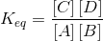
Thermodynamics of Metabolic Pathways
Notes:
Standard free energy
Actual free energy

Slide 10
These chemicals are at nearly equal levels at equilibrium?
ΔG = +2 kJ/mol
This is small
Glucose – 6 – Phosphate
Fructose– 6 – Phosphate
True
False

Slide 11
At equilibrium are these at the same levels?
ΔG = +22 kJ/mol
This is big
True
False
Notes:
This reaction happens all the time, so how does it happen?

Slide 12
Gibbs Free Energy in a Metabolic Pathway

Slide 13
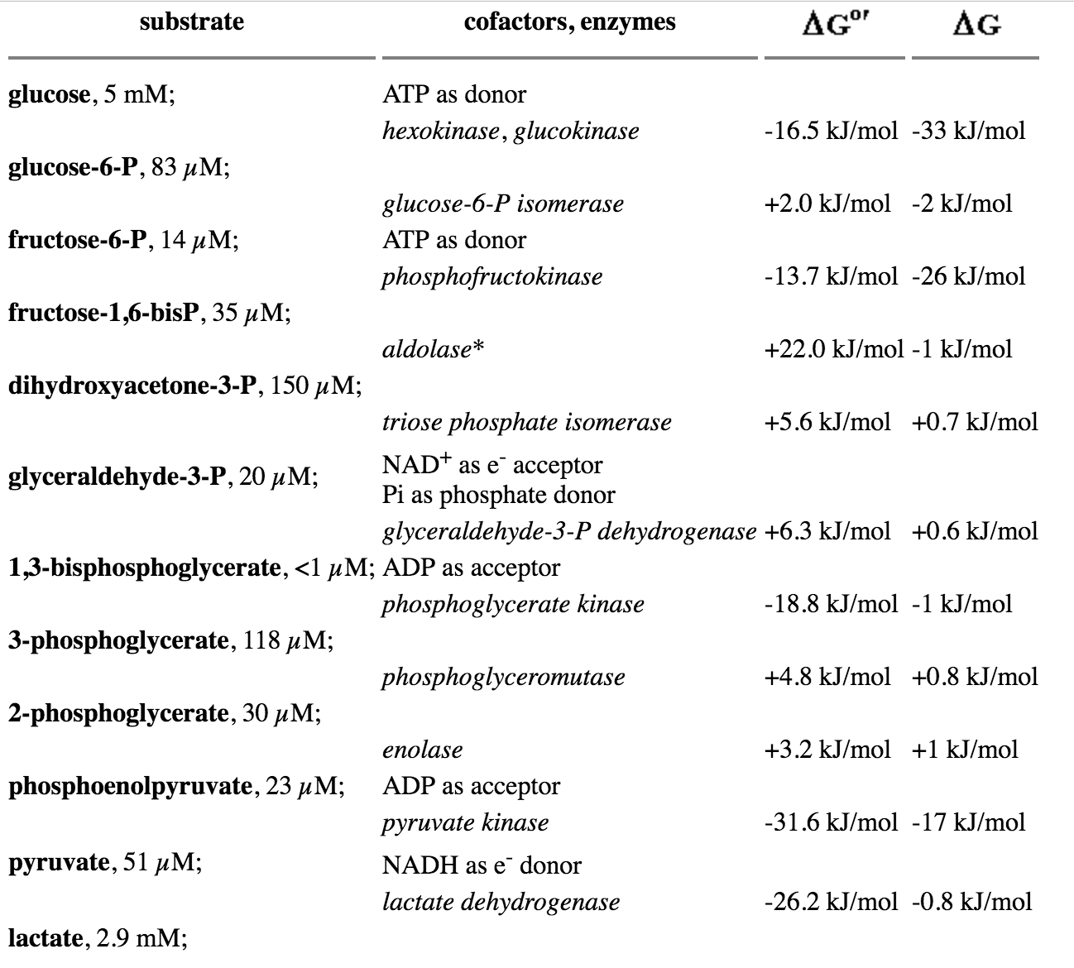
After adjusting for
Concentrations of reactants

Slide 14
Kinetics of Enzyme Reactions
Generally depends on amount of substrate/product
Stabilization of transition state

Slide 15
Rate Limiting Enzyme and Committed Steps
Notes:
Flowers vs Stick Men

Slide 16
Recap committed or rate limiting steps?
Reversible step:
Substrates and products can quickly move back and forth
Committed step:
An effectively irreversible step along a metabolic pathway
Rate limiting step:
The slowest enzymatic reaction in a pathway
These steps are often the ones that regulate the flow of metabolites through the pathway

Slide 17
Co-operativity
Physiological
Range
Enzymatic Rate
Substrate Concentration

Slide 18
If an enzyme is catalytically activated…
It reduces ΔG of the reaction, but does not change the rate
It reduces ΔG of the reaction, and does changes the rate
It doesn’t change the ΔG of the reaction, and does not change the rate
It doesn't change the ΔG of the reaction, but does not change the rate

Slide 19
Enzymes are Regulated by Several Mechanisms
Speed
Substrate/Product Concentrations
Allosteric Control
Catalytic Activation
Enzyme Location
Enzyme Levels
Protein Level -> Translation/Degradation
Transcriptional Regulation
Permanence
Notes:
Allosteric Control

Slide 20
Which is an example of allosteric control of glycogen synthase?
Increasing the intracellular level of the substrate UDP-glucose makes GS add UDP-glucose to glycogen more rapidly
The transcription factor SREBP1c increases the amount of glycogen synthase in the cell
The non-substrate glucose-6-phosphate increases of GS activity
Both A and C

Slide 21
Cellular Transport Mechanisms

Slide 22
Cellular transport
Cells are impermeable to many nutrients
Transport can:
Follow concentration gradient
Passive transport
Push against concentration gradient
Active transport
Same concepts are true for mitochondrial transport

Slide 23
The Energy from Active Transport Can Come from Several Sources

Slide 24
Altering Cellular Transport
With the folks nearby think of as many ways as you can by which you could increase cellular transport of a nutrient (I can think of 5)
Notes:
Increase rate of transporter
Steepen concentration gradient of nutrient
Make more transporters
Change concentration of co- or antiported molecules
Make more ATP

Slide 25
Several Levels of Metabolic Control
Intracellular
Substrate and products
Allosteric activators/inhibitors
Metabolites that activate post-translational modifications
Transcription factors that respond to metabolite levels
Integrated metabolic control
Endocrine signaling
Neural synapses

Slide 26
Example Post-Translational Metabolic Control System
AMP activated protein kinase (AMPK)
Activated when AMP/ATP level is high
What sorts of things would you expect this kinase may regulate?

Slide 27
Example Transcriptional Control System

Slide 28
Basic endocrine regulation of nutrition
Hormones
Metabolic Processes
Postprandial
Insulin
Fasting:
Glucagon – short term glucose
Adrenaline – glucose for muscle
Cortisol – glucose for brain
Glucose
Gluconeogenesis
Glucose Oxidation
Glycogen Storage
Glucose Transport (into Tissues)
Lipids
Fatty Acid Release and Export (Lipolysis)
Fatty Acid Import
Triglyceride Synthesis
Fatty Acid Oxidation
Proteins and Amino Acids
Protein Synthesis or Breakdown
Amino Acid Synthesis or Catabolism
Amino Acid Import or Export
Notes:
Talk about what the hormones are trying to accomplish

Slide 29
What should these hormones do?
Tissue | Carbohydrate Metabolism | Protein Metabolism | Lipid Metabolism
Muscle
Liver
Fat
Notes:
Take 5-10 minutes thinking about this
For the assignment, you will be assigned a hormone and you will have to describe 5 processes that are regulated by your hormone in muscle liver or fat. For example, glucose export in liver and glucose export in adipose tissue are two different processes.
Due midnight on Friday
On Saturday you will be randomly assigned 3 of your peer’s assignments to grade. These peer reviews are due by the time class starts next Wednesday.

Slide 30
Metabolic Control Gone Awry, the Case of Type 2 Diabetes

Slide 31
How do we measure metabolic rates

Slide 32
Parts of the Metabolic Rate Metabolic Rate
Maclean PS, Bergouignan A, Cornier M-A, Jackman MR. Biology’s response to dieting: the impetus for weight regain. Am. J. Physiol. Regul. Integr. Comp. Physiol. 2011;301(3):R581–R600. http://dx.doi.org/10.1152/ajpregu.00755.2010
Notes:
Impact of weight loss on the components of total energy expenditure (TEE). Energy-restricted weight loss impacts every component of energy expenditure. The absolute levels of resting energy expenditure (REE) decline from a loss of metabolic mass and enhanced metabolic efficiency. Nonresting energy expenditure (NREE) declines, unless the level of physical activity and its associated exercise activity thermogenesis (EAT) are substantially increased. This increase must overcome the decline in the TEF that results from lower energy consumption and a decline in nonexercise activity thermogenesis (NEAT) related to loss in overall mass. Increased energetic efficiency of EAT, NEAT, and potentially TEF contribute to the overall decline in NREE.

Slide 33
The 3500 Calorie “Rule”
Based on the amount of calories in a lb of human fat tissue (87% lipid)
Calculate the number of calories in one pound (453g) fat based on Atwater numbers and the percent of lipid in fat.
To lose that amount of weight how many calories would be need to reduced per day, presuming EE is constant. Consider if your timeframe is
One year,
One month,
One week, and
One day
What if someone wanted to lose 35 lbs in 3 months?

Slide 34
This does not work, why?

Slide 35
How do you think over-eating alters the basal metabolic rate?
I think metabolic rate would be lower after over-eating
I think metabolic rate would be higher after over-eating
What do you think fasting or caloric restriction would do to the metabolic rate?

Slide 36
Over/underfeeding and metabolic rates
Leibel R, Osenbaum MIR, Leibel RL, Rosenbaum M, Hirsch J. Changes in energy expenditure resulting from altered body weight. N. Engl. J. Med. 1995;332(10):621–8. http://dx.doi.org/10.1056/NEJM199503093321001

Slide 37
The Biggest Loser Follow-Up Study
Notes:
Those with sustained weight loss, did so even in spite of a more pronounced reduction in RMR after 6 years

Slide 38
A dynamic model of weight loss
Negative energy balance
Loss of mass
Reduction in energy expenditure
Less negative energy balance
Slowing of weight loss
https://www.niddk.nih.gov/bwp

Slide 39
Relevance of caloric elasticity to public policy
USDA Report on a Soda Tax
Taxing Sodas at 20%
Estimated to reduce calories by 40 Cal/day
Non-adapted model
Adaptive model
Hall, K. D. et al. Quantification of the effect of energy imbalance on bodyweight. Lancet 378, 826–837 (2011).

Slide 40
Learning Objectives
Understand what a rate limiting enzyme is, what a committed enzyme step is and what a reversible reaction is.
Explain the differences in speed and persistence of allosteric, post-translational and transcriptional regulation of metabolism.
Describe the role of cellular transport in macromolecular regulation. Understand the differences between active and passive transport.
Describe how hormones alter macronutrient metabolism after a meal.
Explain the roles of hormones that maintain glucose levels in the fasting state.
Understand how metabolic rates are changed in response to diets and overfeeding.

